Slide 1
ADO.NET
(ActiveX Database Objects)

Slide 2
ADO.NET
ADO.NET is a set of classes that expose data access services for .NET Framework programmers.
ADO.NET provides a rich set of components for creating distributed, data-sharing applications

Slide 3
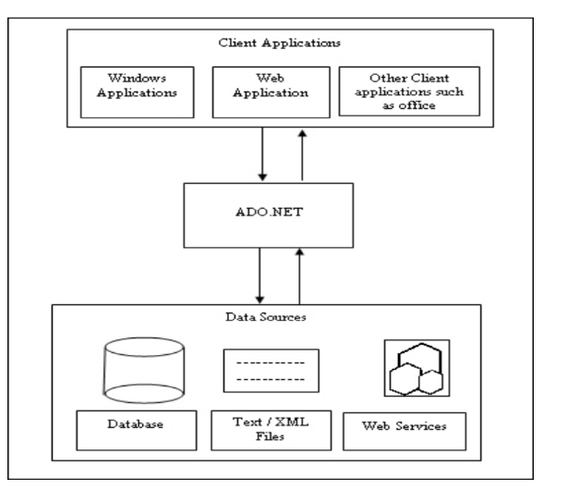
The Role of ADO.NET in Dot Net framework

Slide 4
Data Retreival mechanism
1)Connected architecture 2)disconnected architecture
1) A connected environment is one in which a user or an application is constantly connected to a data source. A connected environment provides the following Advantages:
Data concurrency issues are easier to control. Data is current and updated.
Disadvantages:
A constant network connection may, sometimes, lead to network traffic logging.
2) In a disconnected environment is one in which a user or an application is not directly connected to a data source.
Advantages:
Allows multiple applications to simultaneously interact with the data source.Improves the scalability and performance of applications.
Disadvantages:
Data is not always up to date as no proper connection is established with the data source.
Data concurrency issues can occur when multiple users are updating the data to the data source.

Slide 5
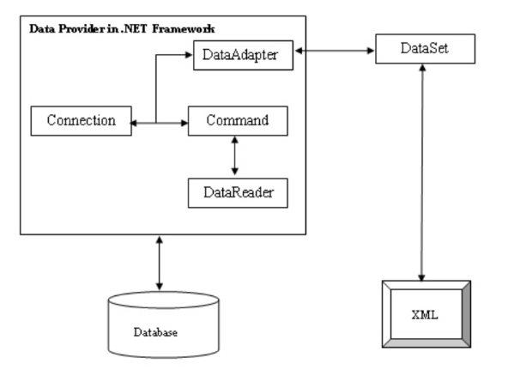
The main components of ADO.NET

Slide 6
ADO.NET has Two parts
1)DataProvider
Connecting to a database.
Retrieving data.
Storing the data in a dataset
Reading the retrieved data.
Updating the database.
2)Dataset
Is a disconnected, cached set of records that are retrieved from a database.

Slide 7
To create and manage connections
Create a connection object.
Create a command object.
Open the connection object.
Execute the SQL statement in the command object.
Close the connection object.

Slide 8
Methods of Command Object
ExecuteNonQuery() Executes a DML statement against a connection object and returns the number of rows affected.
ExecuteReader() Executes the CommandText property against a connection and returns a DbDataReader.
ExecuteScalar() Executes the query and returns the first column of the first row in the result set returned by the query. All other columns and rows are ignored

Slide 9
Connected Envirnment
To make connection
SqlConnection connection =new SqlConnection();
connection.ConnectionString = "Data Source=SQLSERVER01;Initial Catalog=HR;User ID=sa;Password=password";
To specify the query to execute
SqlCommand cmd = new SqlCommand(“SELECT * FROM monthlysalary“,connection);
Open the connection
connection.Open();
In a connected architecture reading data
SqlDataReader myReader =cmd.ExecuteReader();
To close the connection
connection.Close();

Slide 10
DisConnected Envirnment
Disconnected environment A data adapter handles data transfer between the database and the dataset through its properties and methods,
SelectCommand
InsertCommand
UpdateCommand
DeleteCommand
Fill()
Update()

Slide 11
DisConnected Envirnment
To make connection
SqlConnection cn =new SqlConnection();
connection.ConnectionString = "Data Source=SQLSERVER01;Initial Catalog=HR;User ID=root;Password=password";
Create a dataset object to store retrieved data
DataSet DataSet1 = new DataSet();
Create dataadapter object retreive data from data source
SqlDataAdapter da = new SqlDataAdapter();
To specify the query to execute and link to adapter
SqlCommand cmd=new SqlCommand("Select * from Employees", cn);
da.SelectCommand = cmd;
Fill the dataset with retrieved data from datasource using adapter
da.Fill(DataSet1);

Slide 12
Transaction and Transaction Scope
A transaction is a set of related tasks that either succeeds (commit) or fails (abort) as a unit, among other things.Local Transaction is implemented using transaction
For distributed transaction make use of System.Transaction object and transaction scope.A transaction scope defines a block of code that participates in a transaction. If the code block completes successfully, the transaction manager commits the transaction. Otherwise, the transaction manager rolls back the transaction

Slide 13
Local Transaction and Distributed Transaction
Local transactions are performed on a single database server, but distributed transactions can be performed across multiple database servers.
In ADO.NET, controls transactions with the Connection object.
Initiate a localtransaction with the BeginTransaction method.
Once begun a transaction, Enlist a command in that transaction with the Transaction property of a Command object.
commit or roll back modifications made at the data source based on the success or failure of the components of the transaction.

Slide 14
Distributed Transaction
. A distributed transaction is a transaction that affects several resources.
For a distributed transaction to commit, all participants must guarantee that any change to data will be permanent.
Changes must persist despite system crashes or other unforeseen events.
If even a single participant fails to make this guarantee, the entire transaction fails, and any changes to data within the scope of the transaction are rolled back.

Slide 15
Steps of creating distributed transaction:
Instantiate a TransactionScope object.
When TransactionScope is instantiated, the transaction manager determines which transaction to participate in.
While creating TransactionScope object, we need to pass the TransactionScopeOption enumeration with the following values:
Required: A transaction is required by the scope, this uses surrounding transaction if it is already exists, else it creates a new transaction.
RequiresNew: A new transaction is always created for the scope.
Suppress: The surrounding transaction is suppressed when creating scope. All operations in the scope are completed without surrounding transaction.
Open a connection with the database.
Perform your database operations (insert, update & delete).
If your operations completed successfully, mark your transaction as complete.
Dispose The TransactionScope object.

Slide 16
Local Transaction
using (SqlConnection connection = new SqlConnection(connectionString)) { connection.Open(); // Start a local transaction. SqlTransaction sqlTran = connection.BeginTransaction(); // Enlist a command in the current transaction. SqlCommand command = connection.CreateCommand(); command.Transaction = sqlTran; try { // Execute two separate commands. command.CommandText = "INSERT INTO Production.ScrapReason(Name) VALUES('Wrong size')"; command.ExecuteNonQuery(); command.CommandText = "INSERT INTO Production.ScrapReason(Name) VALUES('Wrong color')"; command.ExecuteNonQuery(); // Commit the transaction. sqlTran.Commit(); Console.WriteLine("Both records were written to database."); } catch (Exception ex) { // Handle the exception if the transaction fails to commit. Console.WriteLine(ex.Message); try { // Attempt to roll back the transaction. sqlTran.Rollback(); } catch (Exception exRollback) { // Throws an InvalidOperationException if the connection // is closed or the transaction has already been rolled // back on the server. Console.WriteLine(exRollback.Message); } } }

Slide 17
.NET 2.0 we been provided with TransactionScope class under System.Transaction namespace. This class provides a simple way to make a block of code participate in a transaction without requiring to interact with transaction itself. This class can manage surrounding transactions automatically. The transaction scope is started using the TransactionScope class instance. It is highly recommended to create the TransactionScope object in a using block.
When TransactionScope is instantiated, the transaction manager determines which transaction to participate in. Once this is determined, the scope always participates in that transaction. While creating TransactionScope object, we need to pass the TransactionScopeOption enumeration with the following values:
Required: A transaction is required by the scope, this uses surrounding transaction if it is already exists, else it creates a new transaction.
RequiresNew: A new transaction is always created for the scope.
Suppress: The surrounding transaction is suppressed when creating scope. All operations in the scope are completed without surrounding transaction.

Slide 18
TransactionOptions options = new TransactionOptions();
options.IsolationLevel = System.Transactions.IsolationLevel.ReadCommitted;
options.Timeout = new TimeSpan(0, 2, 0);
using (TransactionScope scope = new TransactionScope(TransactionScopeOption.Required, options))
{
using (SqlConnection connA = new SqlConnection(connStringA))
{
using (SqlCommand cmdA = new SqlCommand(sqlStmtA, connA))
{
int rowsAffectedA = cmdA.ExecuteNonQuery();
if (rowsAffectedA > 0)
{
using (SqlConnection connB = new SqlConnection(connStringB))
{
using (SqlCommand cmdB = new SqlCommand(sqlStmtB, connB))
{
int rowsAffectedB = cmdB.ExecuteNonQuery();
if (rowsAffectedB > 0)
{
transactionScope.Complete();
}
} // Dispose the second command object.
} // Dispose (close) the second connection.
}
} // Dispose the first command object.
} // Dispose (close) the first connection.
} // Dispose TransactionScope object, to commit or rollback transaction.

Slide 19
The scenario was that there were two databases on SQL Server e.g.db1 and db2, both had two separate tables, e.g. Table T1 in db1 and Table T2 in db2. These Databases and Tables were related with each other via business requirements. The application had to insert records in both these tables at the same time. The order of operations was to insert in T1 and then T2. If T2 insert fails, then transaction in T1 should be rolled back.

